Slide 1


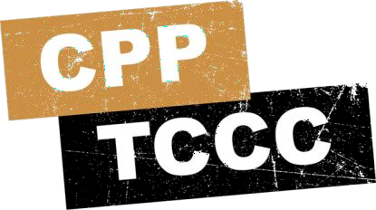
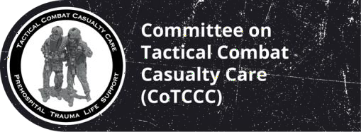
TACTICAL COMBAT CASUALTY CARE COURSE
MODULE 2: MEDICAL EQUIPMENT
Module 2: Medical Equipment
#TCCC-CPP-PPT-02 08 AUG 23
COMBAT PARAMEDIC/ PROVIDER
TCCC TIER 1
All Service Members
TCCC TIER 2
Combat Lifesaver
TCCC TIER 3
Combat Medic/Corpsman
TCCC TIER 4
Combat Paramedic/Provider

Slide 2
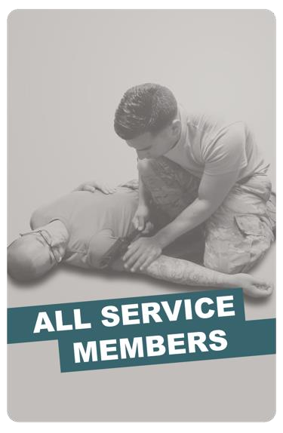
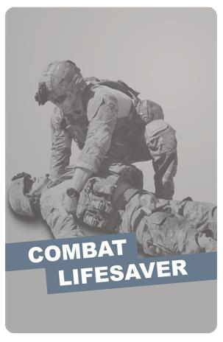
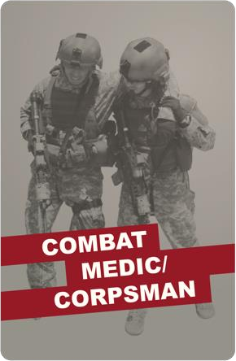
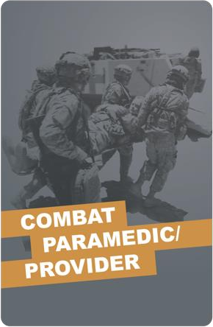
Module 2: Medical Equipment
TACTICAL COMBAT CASUALTY CARE (TCCC) ROLE-BASED TRAINING SPECTRUM
ROLE 1 CARE
NONMEDICAL PERSONNEL
MEDICAL PERSONNEL
YOU ARE HERE
STANDARDIZED JOINT CURRICULUM
#TCCC-CPP-PPT-02 08 AUG 23
2
Notes:
Tactical Combat Casualty Care is broken up into four roles of care. As a Combat Paramedic/Provider, you are the first medical provider to care for the casualty and initiate more advanced treatments in the continuum of prehospital care.
It is important to understand the roles and responsibilities of the nonmedical personnel (All Service Members and Combat Lifesavers) and other medical personnel (Combat Medics/Corpsmen) who may be assessing, providing care/assisting in the treatment of casualties in the prehospital environment. They carry medical equipment appropriate to their respective skill levels and training as well.

Slide 3
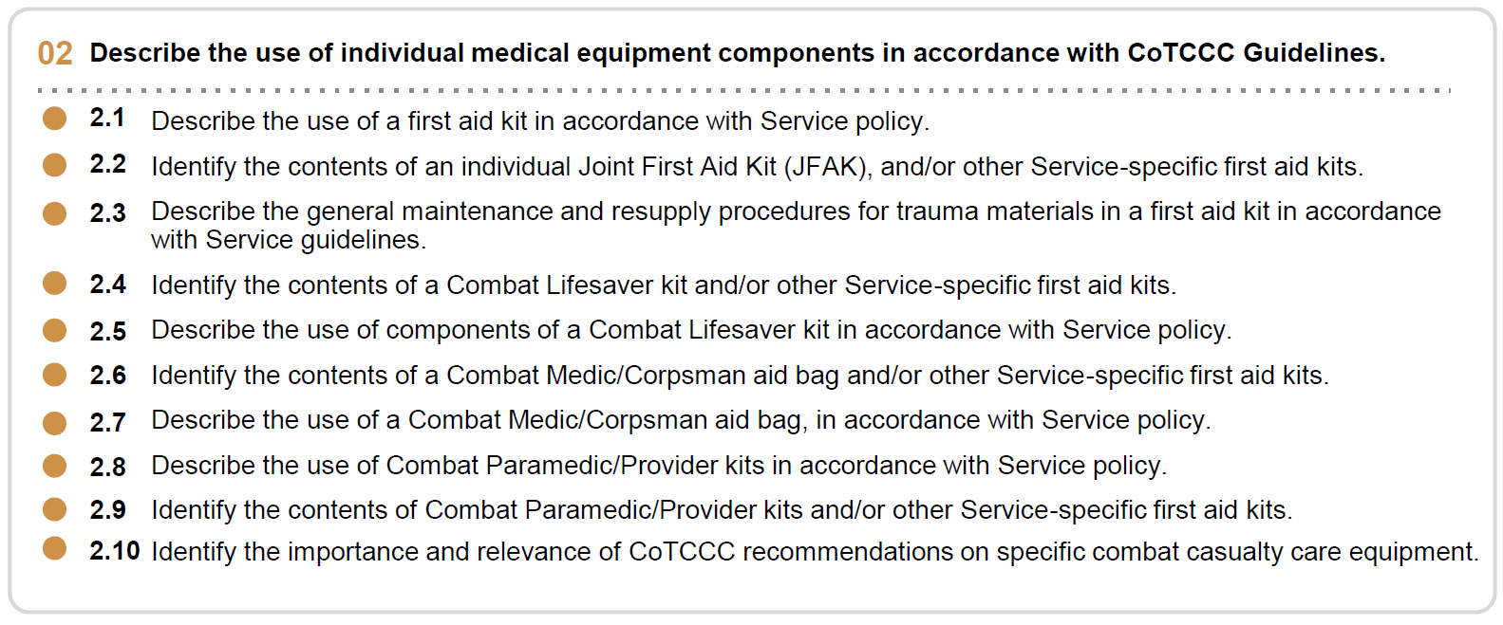








1 x TERMINAL LEARNING OBJECTIVES
Module 2: Medical Equipment
02 Describe the use of individual medical equipment components in accordance with CoTCCC Guidelines.
2.1
2.2
2.3
Describe the use of a first aid kit in accordance with Service policy.
Identify the contents of an individual Joint First Aid Kit (JFAK), and/or other Service-specific first aid kits.
Describe the general maintenance and resupply procedures for trauma materials in a first aid kit in accordance with Service guidelines.
  Identify the contents of a Combat Lifesaver kit and/or other Service-specific first aid kits.
  Describe the use of components of a Combat Lifesaver kit in accordance with Service policy.
  Identify the contents of a Combat Medic/Corpsman aid bag and/or other Service-specific first aid kits.
  Describe the use of a Combat Medic/Corpsman aid bag, in accordance with Service policy.
  Describe the use of Combat Paramedic/Provider kits in accordance with Service policy.
  Identify the contents of Combat Paramedic/Provider kits and/or other Service-specific first aid kits.
2.10 Identify the importance and relevance of CoTCCC recommendations on specific combat casualty care equipment.
10 x ENABLING LEARNING OBJECTIVES
= Terminal Learning Objectives = Cognitive ELOs = Performance ELOs
#
#TCCC-CPP-PPT-02 08 AUG 23
3
Notes:
During this module, we will discuss the medical equipment used during Tactical Combat Casualty Care, including the importance and relevance of CoTCCC recommendations on the use of specific combat casualty care equipment. There are ten learning objectives starting with understanding how first aid kits are used in accordance with Service policy.
In addition to identifying the contents of the individual Joint First Aid Kit (JFAK), combat lifesaver kits, medic or corpsman aid bags, and combat paramedic/provider kits, we’ll go over the use of those kits and the general maintenance and resupply procedures as defined by the Services.

Slide 4
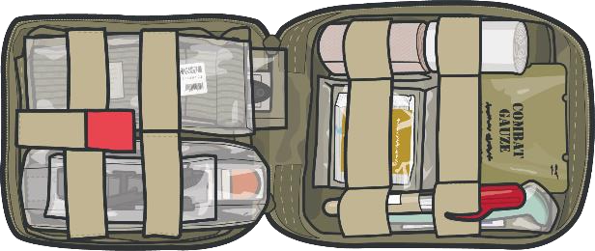
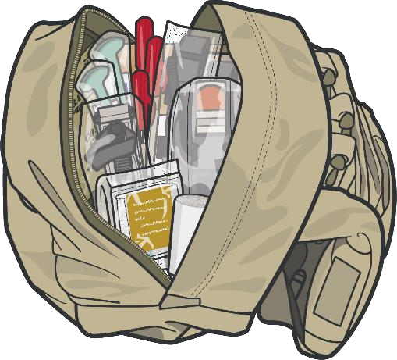

FIRST AID KITS WHAT DO I TAKE?
Module 2: Medical Equipment
INDIVIDUAL
Joint First Aid Kit (JFAK)
COMBAT LIFESAVER BAG
CLS Bag
Unit Standard Operating Procedures (SOPs) and individual responder capabilities/scope of care will determine what is carried in the First Aid Kits
Notes:
Medical personnel will have to prepare for the mission tasks in a combat environment every time. You must adapt to current information about your upcoming deployment. Enemy tactics, techniques, and procedures (TTPs) constantly evolve and should constantly be reevaluated, which may change your medical equipment recommendations.
Using threat-based planning (understanding available medical assets, intrinsic and local medical capabilities, and potential casualties, including evolving wound patterns) will provide medics with the information needed to organize their First Aid Kits more effectively. Knowing your capabilities, such as theatre operations movement assets, will assist you in packing for your deployment. Given the differences in medical provider training and supplies within each Service, you may deploy with a different medical bag.

Slide 5
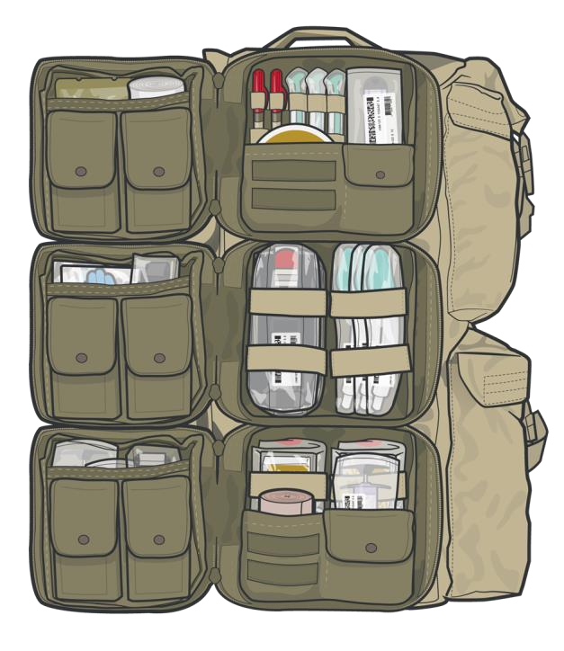
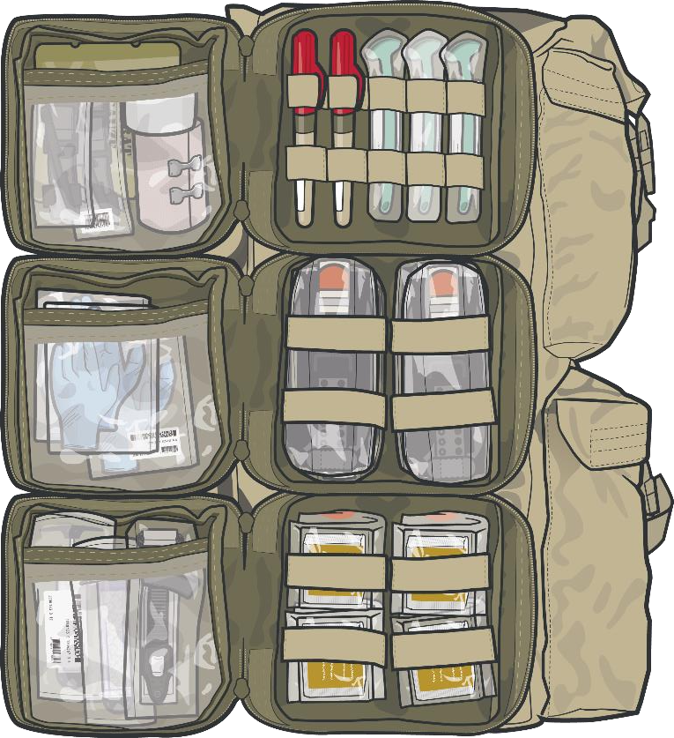
MEDICAL SUPPLIES
YOU WILL NEED TO PROVIDE AID AND SAVE LIVES
Module 2: Medical Equipment
INDIVIDUAL
Joint First Aid Kit
(JFAK)
COMBAT
LIFESAVER BAG
CLS Bag
COMBAT MEDIC/ CORPSMAN AID BAG
CMC Aid Bag
COMBAT PARAMEDIC/ PROVIDER KITS
Notes:
The main categories of kits you need to be familiar with are:
Joint First Aid Kit (JFAK): used by nonmedical personnel, who are proficient in basic lifesaving TCCC skills.
Combat Lifesaver (CLS) Bag: used by nonmedical personnel, who have been trained above and beyond basic lifesaving TCCC skills to treat the most common causes of death on the battlefield to recognize more serious injuries, prevent further deterioration, and communicate effectively with medical personnel.
Combat Medic/Corpsman (CMC) Aid Bags: used by medical personnel who have received more advanced training and are the first medical personnel to care for the casualty in the prehospital environment and are expected to provide more advanced combat casualty care.
Combat Paramedic/Provider (CPP) Kit: used by more advanced medical personnel/providers who are expected to provide more advanced care requiring significantly more medical knowledge and skills.
The contents of each of these kits are similar but reflect the TCCC scope of care of the responders intended to use the kit. If there are equipment options approved by the Committee on Tactical Combat Casualty Care (CoTCCC), those must be used.
This lesson provides an opportunity to get a hands-on introduction to the kits and their contents. The equipment discussed supports the provision of TCCC per the current guidelines and enables the All Service Members, Combat Lifesaver, Combat Medic/Corpsman, or Combat Paramedic/Provider to address issues identified in Care Under Fire, Tactical Field Care, and TACEVAC Care using the MARCH PAWS approach.

Slide 6
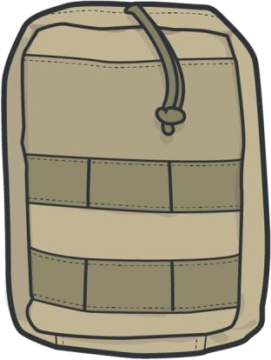
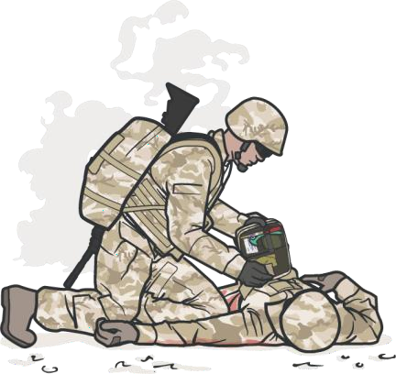

JFAK CONTENT AND CAPABILITIES
Module 2: Medical Equipment
Items included in this kit can treat the following:
Tourniquet, hemostatic dressing, and pressure
bandages
Nasopharyngeal
airway
M
A R C H
P
A W S
Other:
Combat wound medication pack
Combat wound
medication pack
Chest seal and NDC 10-14 gauge 3.25” needle catheter
Gauze and rigid
eye shield
INDIVIDUAL
JFAK
ALWAYS use the
casualty's JFAK first
DD Form 1380 and a marker
Notes:
Service members in today’s military carry a large array of equipment, and survival on the battlefield depends heavily on the ability to properly use that equipment. One piece of equipment that is critically important is the Joint First Aid Kit (JFAK).
Every piece of equipment chosen for the JFAK is evidence-based (based on lessons from years of war in Iraq and Afghanistan) and serves a distinct purpose for the individual Service member; knowing how to properly use what is in the JFAK can save a life.
Remember, when treating a casualty (providing combat life saver or medic-level aid), use the items that are in the casualty’s JFAK first. Each Service member’s JFAK should be reserved for self-aid whenever possible.
Every item that is in a JFAK supports the provision of TCCC per the current guidelines. As massive hemorrhage, airway obstruction, and respiratory problems account for such a significant portion of preventable battlefield deaths, the JFAK equipment focuses on supporting treatments that address those concerns. Tourniquets, hemostatic dressing, and pressure bandages support massive hemorrhage treatment, nasopharyngeal airways address airway obstruction support, and chest seals and needles to decompress the chest address common respiratory concerns. Also, a Combat Wound Medication Pack should have been issued and added to the JFAK, and a DD Form 1380 is available for documentation purposes.

Slide 7
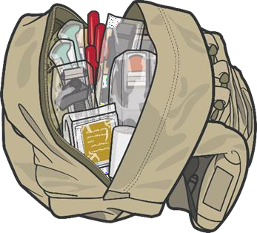



COMBAT LIFESAVER BAG CONTENT AND CAPABILITIES
Module 2: Medical Equipment
Items included in this kit can treat the following:
M
A R C H
Tourniquets, hemostatic dressing, and pressure bandages
Combat wound
medication pack
Combat wound medication pack
P
A W S
Other: DD Form 1380 and
MEDEVAC Request Card
Nasopharyngeal airway
Vented chest seal, bag valve mask, and NDC 10-14 gauge 3.25” needle catheter
Gauze and rigid eye shield
BUDDY AID
Combat Lifesaver Bag
Splinting material, cravats, and elastic wraps
Gauze and elastic bandage
Active/Passive Hypothermia
Kits/Blankets and MACE 2
Notes:
The Combat Lifesaver provides not only an additional level of medical training but also additional equipment. Some of the equipment in a CLS kit mirrors those items in the individual’s JFAK (tourniquets, dressings and bandages, chest seals, etc.).
As you know, or will learn, casualties often suffer multiple injuries and require more equipment than they carry in their own JFAK, and the CLS kit supports that requirement. In addition to the items previously highlighted, the CLS kit also typically has active and/or passive hypothermia prevention kits, additional supplies for wound care, as well as splints and cravats for fracture stabilization. Based on unit- and Service-specific considerations, there is more variability in the CLS kit than the JFAK.
When treating a casualty (providing combat lifesaver or medic-level aid), use the items that are in the casualty’s JFAK first.
It is important to understand the potential operational impact of a heavy fighting load, which can be compounded by the weight of the CLS bag (or the Combat Medic/Corpsman aid bag). This must be considered when packing medical equipment and every effort made to reduce excess weight as much as possible without compromising casualty care.

Slide 8
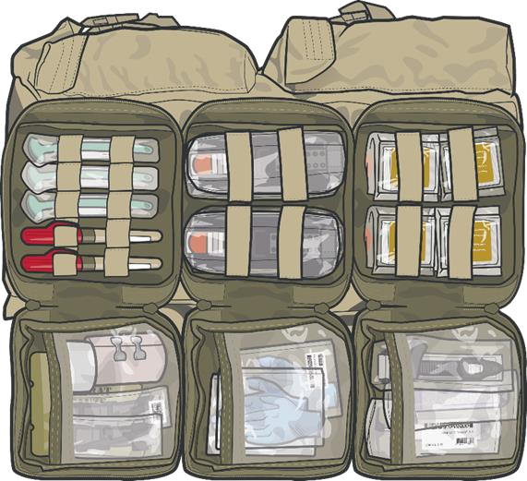

COMBAT MEDIC/CORPSMAN CONTENT AND CAPABILITIES
Module 2: Medical Equipment
Items included in this kit can treat the following:
M A R C
H
Tourniquet, hemostatic dressing, pressure bandage, junctional tourniquet, X-stat®, and wound closure device
Nasopharyngeal airway, extraglottic airway, cricothyroidotomy kits, and suction devices
Bag valve mask, vented chest seals, NDC 10-14 gauge
3.25” needle catheter
Pelvic compression devices, Intravenous (IV) and Intraosseous (IO) access kits, IV fluids, EldonCard™, tranexamic acid (TXA), blood products, and calcium
Active/Passive Hypothermia Kits/Blankets, IV fluid warmers, and MACE 2
ADVANCED TCCC CARE
Combat Medic/Corpsman Aid Bag
Stock this bag in accordance with your SOPs/Protocols
Notes:
The Combat Medic/Corpsman aid bag has equipment similar to that in the CLS bag but provides an additional quantity of TCCC lifesaving equipment to support care of multiple casualties.
The enhanced skill set of the Combat Medic/Corpsman also warrants additional medical equipment not found in the CLS bag to support a broader scope of care. For example, the CMC aid bag contains junctional tourniquets for massive hemorrhage control, advanced airways and cricothyroidotomy kits for airway management, and intravenous and intraosseous access supplies, IV fluids, blood products, and medications to address circulation issues and shock, to name a few.

Slide 9
COMBAT MEDIC/CORPSMAN CONTENT AND CAPABILITIES (cont.)
Module 2: Medical Equipment
Items included in this kit can treat the following:
P
A W S
Other: DD Form 1380, MEDEVAC Request Card, Mission/Unit specific equipment
Pain medications, extra combat wound medication packs
Antibiotics, extra combat wound medication packs
Gauze, elastic wrap, and rigid eye shields
ADVANCED TCCC CARE
Combat Medic/Corpsman Aid Bag
Malleable splints, rigid splints, cravats, and elastic wraps
Stock this bag in accordance with your SOP/Protocols
Notes:
As with the CLS kits, Combat Medic/Corpsman aid bags do not follow a specified packing list but rather are tailored based upon Service-specific policies, unit SOPs, and mission-specific planning considerations.

Slide 10


COMBAT PARAMEDIC/PROVIDER CONTENT AND CAPABILITIES
Module 2: Medical Equipment
Contents of this kit will be similar to the CMC Aid Bag but will include additional items appropriate for more advanced skill set including:
Additional medications, including those needed for rapid sequence induction and intubation in more advanced airway management
Advanced airway equipment including endotracheal tubes, laryngoscope, etc. for endotracheal intubation
Other advanced equipment specific to provider skill
set, mission, unit, etc.
ADVANCED TCCC CARE
Combat Paramedic/Provider Bag
Stock this bag in accordance with your SOP/Protocols
Notes:
The contents of this kit will be similar to the CMC aid bag but include additional items appropriate for the more advanced practitioner, including the equipment and medications needed for advanced airway management, rapid sequence induction and intubation, and other equipment specific to the individual provider’s experience and skill set. The specifics of advanced airway management and rapid sequence induction and intubation will be discussed in detail in a later module.
This review of the content of the various aid bags and kits is not intended to be a comprehensive listing of all equipment but rather highlights the varying equipment requirements of the kits needed to support the respective scopes of care of the different TCCC practitioners.
You can see from this fairly extensive list of potential equipment and supplies, the size and weight of the aid bag can easily exceed the capacity of any one warfighter, and consideration should be given to cross-leveling equipment and supplies among other members of the unit. For example, additional resuscitation fluids, dressings, etc., can be carried by teammates to make the load more manageable.

Slide 11
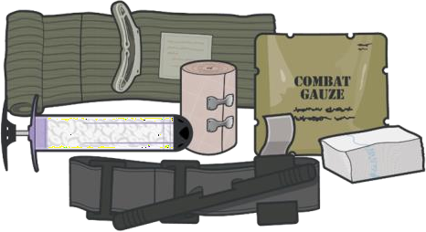
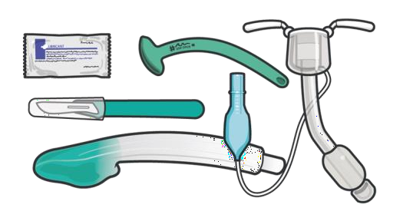
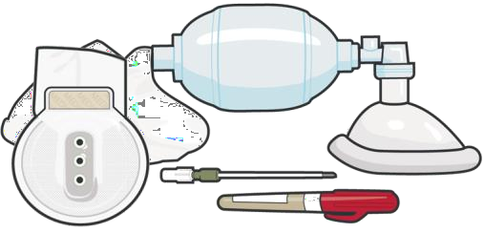
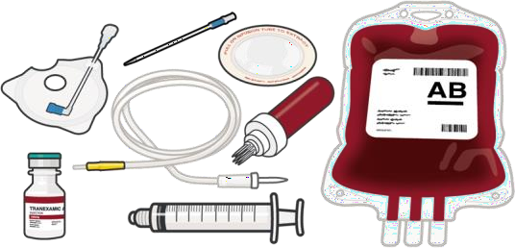
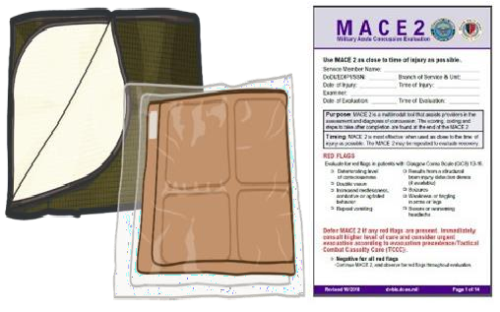
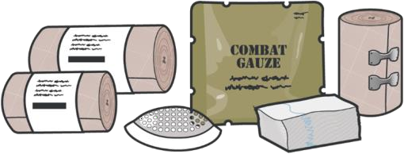
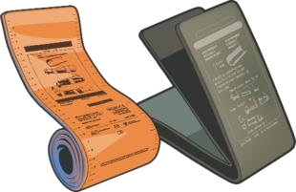
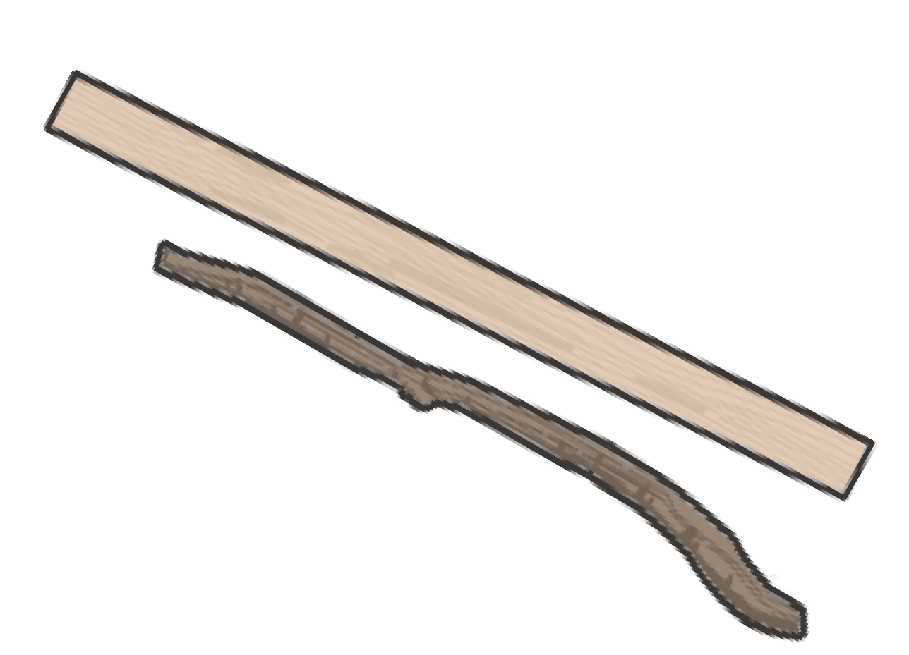
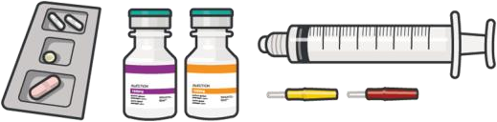
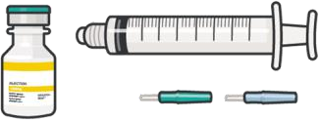
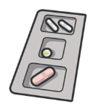
Module 2: Medical Equipment
M
MASSIVE HEMORRHAGE
A
AIRWAY
R
RESPIRATIONS
C
CIRCULATION
H
HYPOTHERMIA/ HEAD INJURY
P
PAIN
A
ANTIBIOTICS
W
WOUNDS
S
SPLINTING
Notes:
Throughout this course, you will be learning about the details of most of this equipment. Identifying which items have CoTCCC-recommended options, specific information about the actual materials, and describing how they are used is part of each course module. But an introduction to key equipment items might help set the stage.
The MARCH PAWS concept offers an organized approach to familiarizing you with basic TCCC equipment. We won’t be going over how the kits are organized or packed, but a general concept that has been highlighted by medics with deployment experience is to organize the equipment in such a way that items needed early in a casualty treatment scenario are very accessible. Grouping items that are likely to be used together into smaller packages within the main kit (like IV start kits with the IV fluids) helps increase efficiencies and probably improves casualty outcomes.

Slide 12
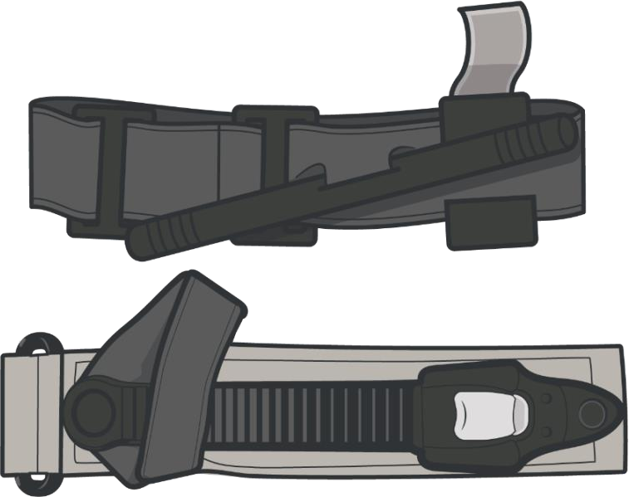
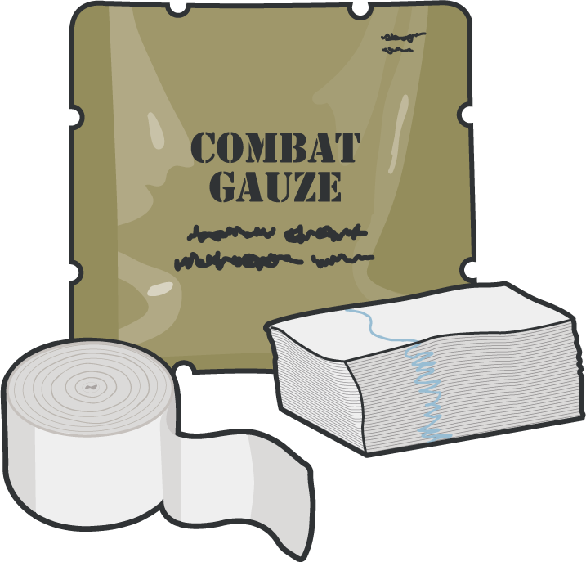
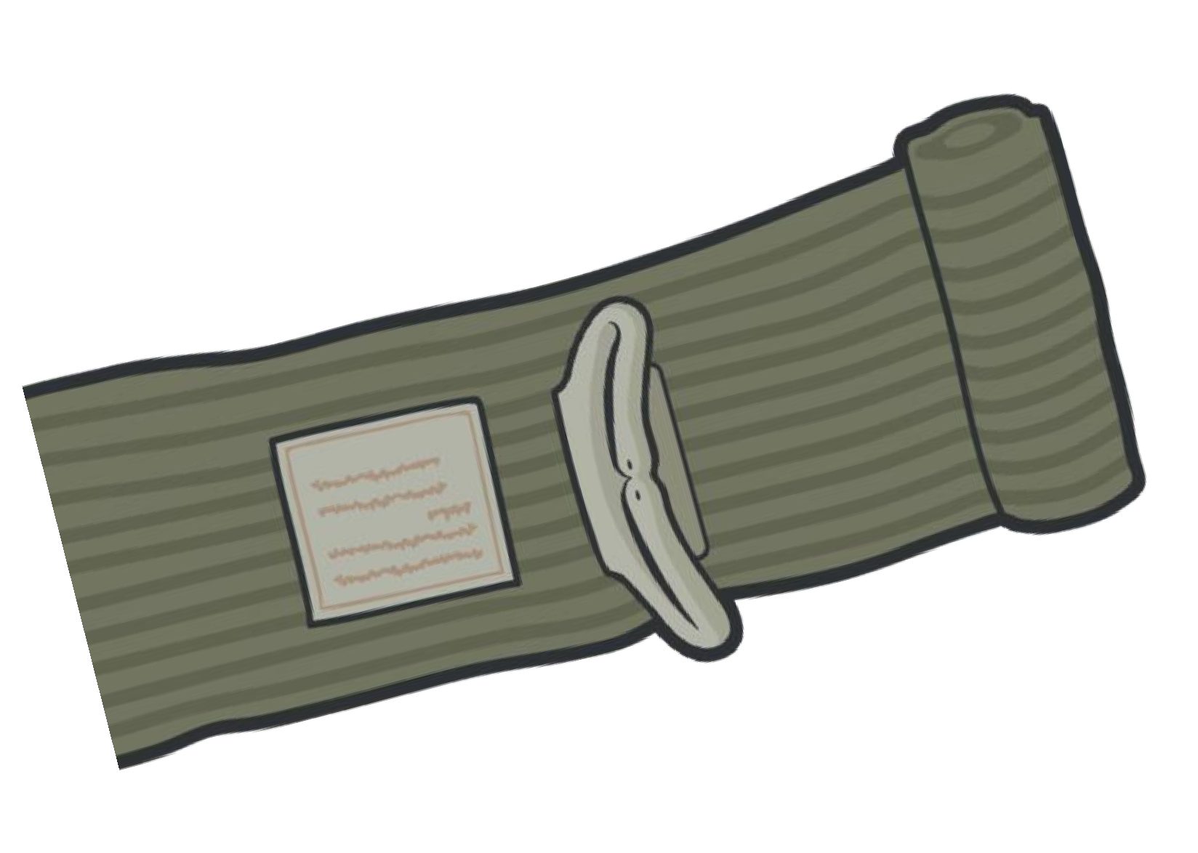
M ASSIVE HEMORRHAGE EQUIPMENT
Module 2: Medical Equipment
TOURNIQUET
CoTCCC-recommended and is used to control massive or severe hemorrhage of an extremity
HEMOSTATIC DRESSING
CoTCCC-recommended dressing, contains a chemical that bonds to another chemical in blood and causes clots to form at the source of bleeding
PRESSURE BANDAGE
Elastic bandage used as a pressure dressing and/or standard dressing
Notes:
Lessons learned in previous conflicts remain true; hemorrhage is the number one killer in combat.
With massive hemorrhage accounting for the largest number of preventable deaths on the battlefield, the equipment to support bleeding control is found in almost all kits. Key items are highlighted here.
CoTCCC-recommended tourniquets are used to control massive or severe hemorrhage (bleeding) of an extremity (arms and legs). This is the most important lifesaving item in the JFAK and should be kept easily accessible and ready for use.
CoTCCC-recommended hemostatic dressings are called for when severe bleeding is observed from a wound in an area where a tourniquet cannot be used (groin, neck, axillary wounds) or when a wound is not severe enough to warrant a tourniquet.
Emergency bandages or trauma dressings are elastic bandages that can be used alone or along with other forms of hemorrhage control (like hemostatic dressings) to enhance effectiveness in controlling bleeding by providing pressure to the wound.

Slide 13
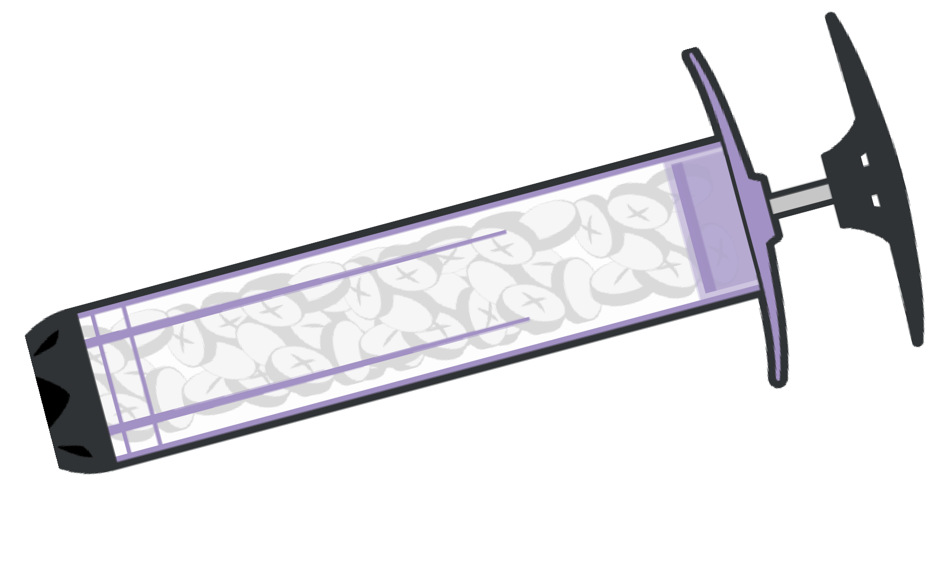
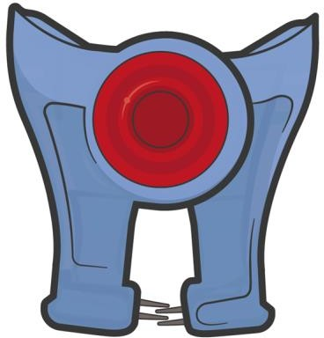
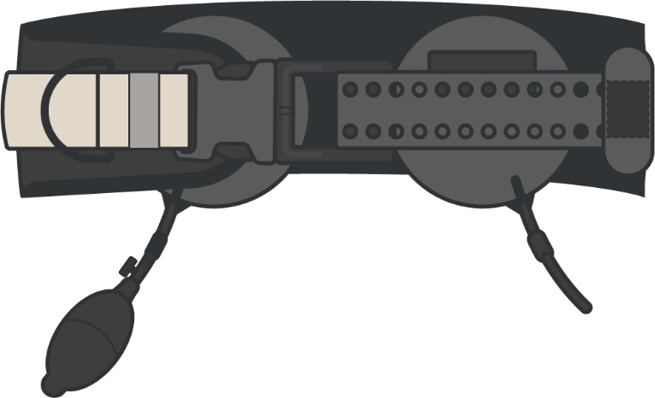
M ASSIVE HEMORRHAGE EQUIPMENT (cont.)
Module 2: Medical Equipment
JUNCTIONAL TOURNIQUET
Designed to stop massive hemorrhage from large vessel injuries of the groin or axilla that are too proximal for a limb tourniquet to be used effectively
XSTAT 30 (LARGE)
XSTAT 12 (SMALL)
Designed to inject an expandable agent into the wound cavity to create an internal source of pressure at the bleeding site
WOUND CLOSURE DEVICE
The device seals the edges of a wound closed to mitigate further blood loss until the wound can be surgically repaired
Notes:
For areas where you cannot place a tourniquet, such as the armpit or groin, a junctional tourniquet should be used. Injectable hemostatic agents are products that stop internal bleeding using nonabsorbable hemostatic sponges that expand and assist in bleeding control. The wound closure device seals the edges of a wound closed to mitigate further blood loss until the wound can be surgically repaired.

Slide 14
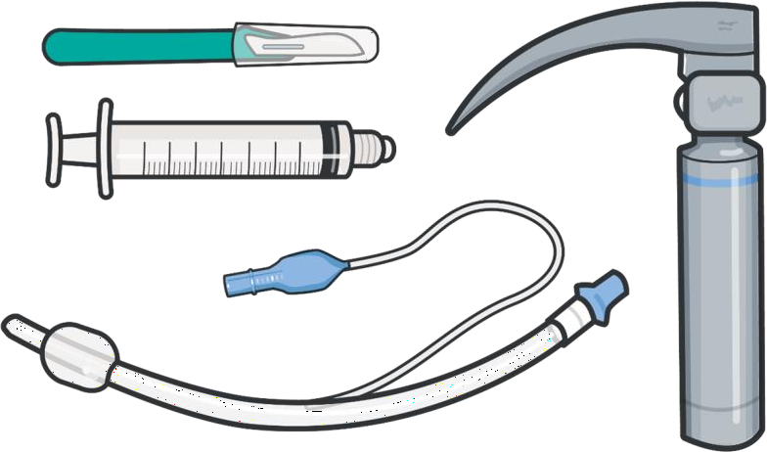
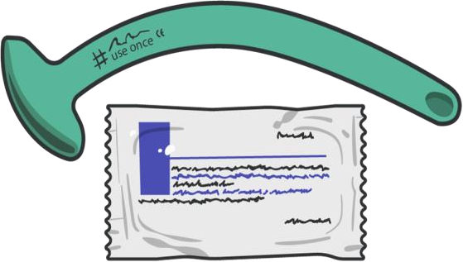
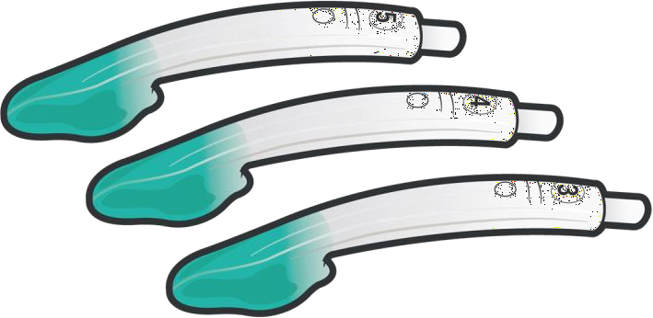
A IRWAY CONTROL EQUIPMENT
Module 2: Medical Equipment
NASOPHARYNGEAL
AIRWAY (NPA)
Nonsterile rubber tube-shaped device inserted into the casualty’s nostril
EXTRAGLOTTIC AIRWAY (EGA)
Used to establish an airway for oxygenation and ventilation without entering the trachea
SURGICAL AIRWAY/ETT
INTUBATION KIT
An advanced surgical airway/ETT intubation kit is used when other airway adjuncts have failed, as well as an airway obstruction or pending airway obstruction
Notes:
You may encounter several airway adjuncts in your equipment kits. At all kit levels, you are likely to find nasopharyngeal airways with lubricants used to keep the airway open by preventing the tongue from occluding the airway.
With higher-level kits, you may find bag valve masks (BVM), as well as more invasive airway adjuncts like extraglottic airways and cricothyroidotomy kits. These products establish an advanced airway without the use of intubation equipment. Some of the extraglottic products used are the i-gel®, Combitube, LMA, and King LT.
With the CPP kits, you may find the equipment needed to perform a definitive airway with endotracheal intubation, which will all be covered in the airway module. Surgical cricothyroidotomy kits can provide a surgical airway to a patient by creating a surgical opening in the cricothyroid membrane between the larynx and the cricoid cartilage. This should be a LAST RESORT procedure.

Slide 15
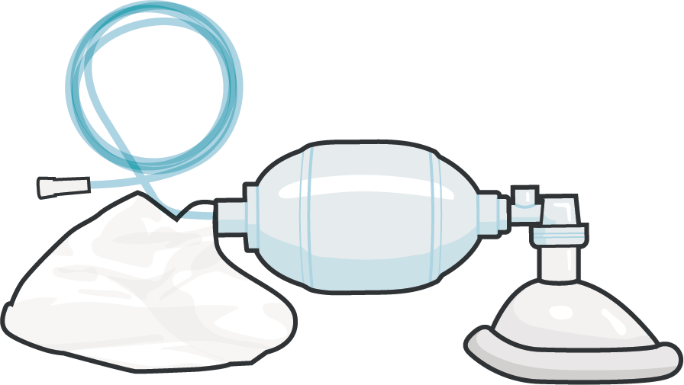

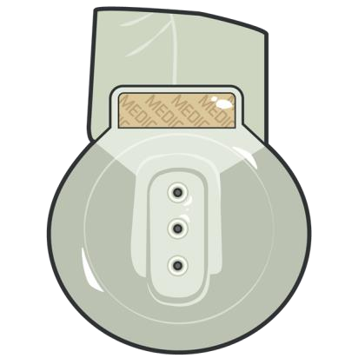
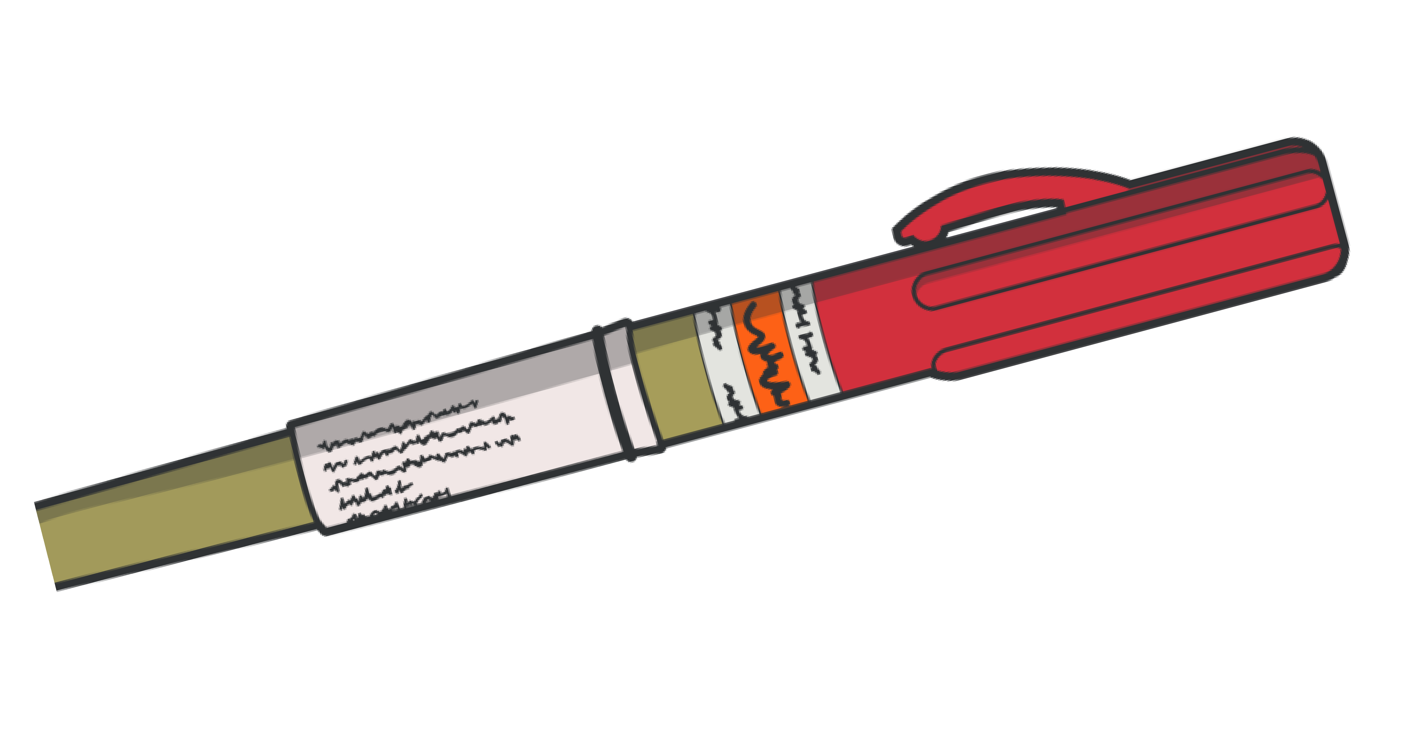
R ESPIRATION SUPPORT EQUIPMENT
Module 2: Medical Equipment
BAG VALVE MASK (BVM)
Provides positive pressure ventilations to a patient who is inadequately breathing or not breathing at all
VENTED CHEST SEAL
Vented and adhesive chest seal for treating penetrating chest wounds, if a vented chest seal is not available use a non-vented chest seal
10-14 GAUGE 3.25”
NEEDLE CATHETER
Catheter-over-needle device inserted into the chest to treat tension pneumothorax
Notes:
If the casualty requires artificial respirations, the BVM should be used. With or without oxygen, the BVM can be added to a medical kit in a compact state; check for any degrading of the BVM material before deployment.
You will find two other items to support respiration issues in most equipment sets: chest seals and needles for needle compressions. Chest seals, preferably vented, provide a self-adhering seal used for treating penetrating chest wounds. Although often referred to as a needle, the piece of equipment used to treat tension pneumothorax is actually a catheter-over-needle device, allowing the needle to be removed and the catheter to remain in place after use.

Slide 16
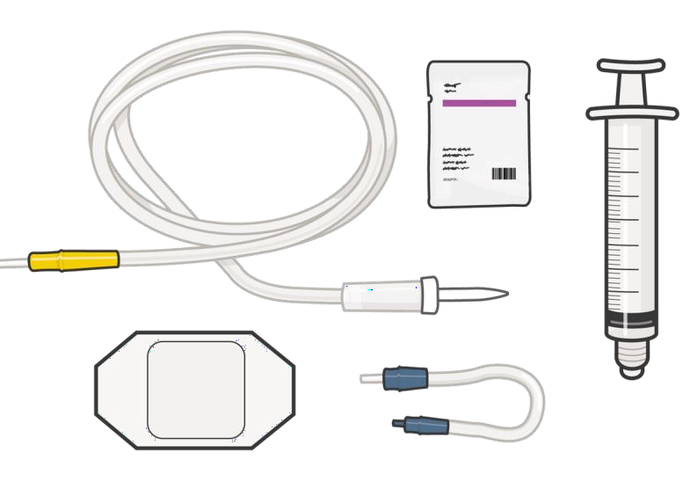
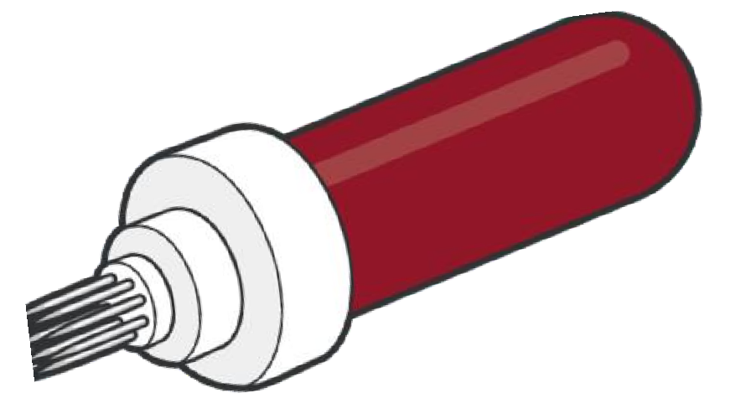
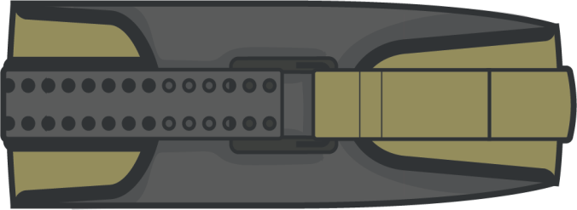
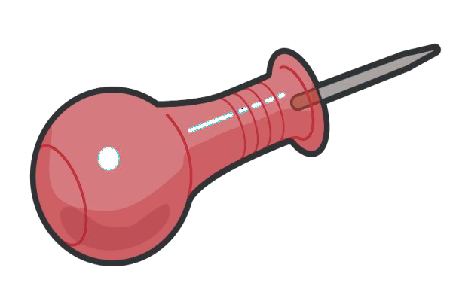
C IRCULATION EQUIPMENT
Module 2: Medical Equipment
PELVIC
COMPRESSION DEVICE
Designed to compress a pelvis fracture, providing stability and preventing ongoing hemorrhage
INTRAVENOUS (IV)
ACCESS KIT
The necessary supplies to
establish intravenous access
INTRAOSSEOUS (IO)
ACCESS EQUIPMENT
Equipment necessary to establish sternal, humeral, or tibial intraosseous access
Notes:
Most of the equipment to support circulation and shock issues is found in the CMC and CPP kits, as opposed to the other kit levels. Replacing lost blood from hemorrhage requires access to administer resuscitation fluids/blood products. One common approach is intravenously, which requires several supplies – catheters, the equipment to start an IV, and a saline lock or IV tubing. Also, intraosseous access can provide a quick and reliable source of access to give medications, blood, or resuscitation fluids, and can be established at sternal, humeral, or tibial sites.
Once access is established, blood products and/or fluids need to be given. Depending on the situation, your equipment will include those supplies, or you may need other equipment to draw blood from unit members serving as a walking blood bank.

Slide 17
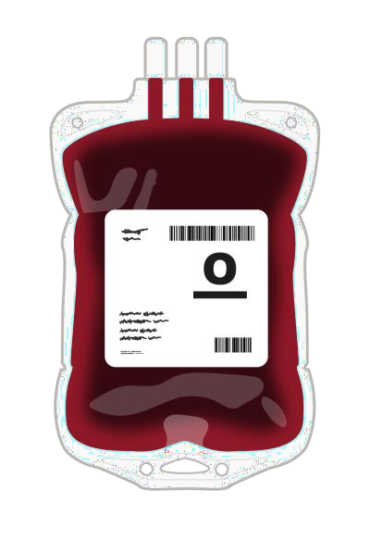
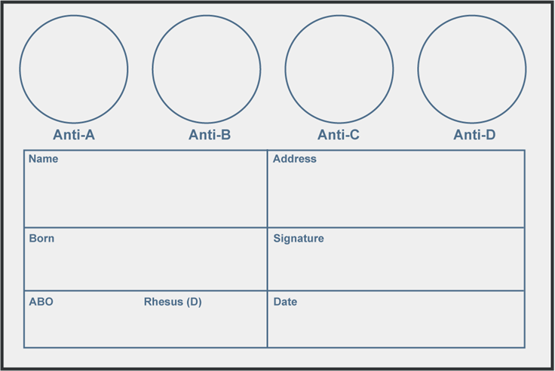
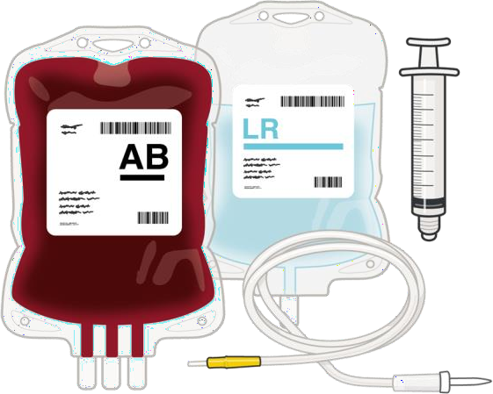
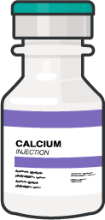
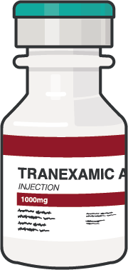
C IRCULATION EQUIPMENT (cont.)
Module 2: Medical Equipment
ELDONCARD™
A card used to determine blood type
TXA
Tranexamic acid – to help the casualty’s blood clotting process
BLOOD PRODUCTS, IV
FLUIDS, AND CALCIUM
Blood products and fluids – to replace casualty losses due to hemorrhage
Notes:
If you are drawing blood from within the deployed forces, the EldonCard™ is a blood test kit that is transportable, compact, and easy to use. The test does not require refrigeration but does require clean drinking water. The kits are available for individual use, while a military kit can be used for larger groups.
To prevent and/or help treat shock from internal hemorrhage, you may need to apply a pelvic compression device.
And to help support clotting and reduce bleeding risk, you should have tranexamic acid (TXA) available.

Slide 18
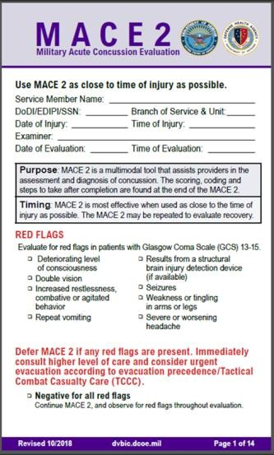
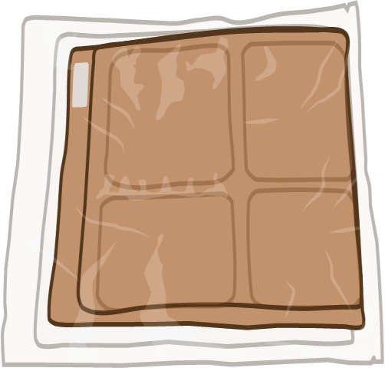
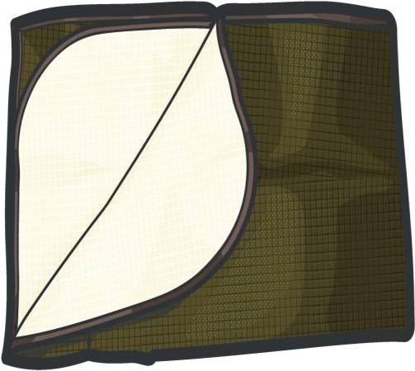
H YPOTHERMIA AND HEAD INJURY
Module 2: Medical Equipment
ACTIVE PASSIVE
ACTIVE/PASSIVE HYPOTHERMIA
KITS/BLANKETS
Used to prevent and manage hypothermia
MILITARY ACUTE CONCUSSION
EVALUATION (MACE 2)
Used to identify possible traumatic
brain injury (TBI)
NOTE: DD Form 1380 is also used in AVPU (alert, verbal, pain, unresponsive) assessment as part of head injury documentation
Notes:
At the CLS, CMC, and CPP kit levels, you should find hypothermia prevention equipment. These may be hypothermia prevention kits (which provide active prevention) and/or various types of blankets (which are a passive form of preventing hypothermia).
Although there are no materials that specifically address head injury treatment, the AVPU assessment can be documented on the DD Form 1380. The CMC and CPP kits will include military acute concussion evaluation forms, called the MACE 2, which uses evidence-based guidelines for evaluating a traumatic brain injury.

Slide 19








P AIN and A NTIBIOTIC MEDICATIONS
Module 2: Medical Equipment
COMBAT WOUND MEDICATION PACK
Moxifloxacin
400 mg tablet
Meloxicam
15 mg tablet
Acetaminophen
x2 500mg
PAIN MEDICATIONS
For pain not controlled by the CWMP, other pain medications that can be administered by many different routes are available.
ANTIBIOTICS
If time and situation allow, IV antibiotics can be administered, if indicated.
RSI MEDICATIONS
Needed to support rapid sequence induction (RSI) and intubation for advanced airway management.
Notes:
The Combat Wound Medication Pack, or CWMP, is a prepackaged medication packet with drugs and dosages specifically chosen for use in combat casualty care and contains drugs for mild to moderate pain (meloxicam and acetaminophen) and an antibiotic specific for penetrating wounds (moxifloxacin). The CMC kits bring additional medications that support the management of pain that isn’t controlled by the CWMP and IV antibiotics that are used if the time and situation allow.
There are multiple types of pain medications that allow for administration by mouth, intranasally, or by IV or IO access. Additionally, the CPP kits may contain medications needed to support rapid sequence induction and intubation for advanced airway management.

Slide 20




W OUND MANAGEMENT EQUIPMENT
Module 2: Medical Equipment
GAUZE
Gauze rolls used to stop minor bleeding or as bulky material for wound packing, hemostatic properties to promote wound clotting
ELASTIC WRAP
Stretchable cloth like wrap used to hold medical different types of medical intervention equipment in place
RIGID EYE SHIELD
A shield that provides domed protection of the eye WITHOUT applying pressure
Notes:
Life-threatening wounds will have already been addressed using the equipment we’ve just talked about, but there are often other wounds to consider, like eye injuries, burns, or minor lacerations. Many of the kits contain compressed gauze or gauze rolls that are used to stop minor bleeding, cover wounds/burns, pack wounds, act as bulky material for pressure dressings, or pad pressure points in splinting. Also, the elastic bandages previously mentioned can be used to hold dressings or splints in place or can be applied more tightly to apply localized pressure on a wound. Eye injuries are a common and unique injury, and for that reason, rigid eye shields, plastic, or metallic domed-shaped stiff shells provide protection of eye injuries without applying pressure to the eye and causing further damage.

Slide 21


S PLINT EQUIPMENT
Module 2: Medical Equipment
MALLEABLE SPLINTING
Semi-rigid material used to immobilize an injured limb
RIGID SPLINTING
Rigid splinting material that stabilizes the limb and protects the injury
Notes:
Broken bones are a common injury, and both CLS, CMC, and CPP kits usually have equipment to splint those fractures. Malleable splints can be shaped to fit the needs of various fractures; however, they must be adequately bent to function properly. Cravats can be used to secure a splint or to create a sling or a swath. Femur fractures, or long bone fractures, can sometimes compromise the lower leg unless traction is applied during the splinting process, and some kits will come with traction splints to support that requirement.

Slide 22



DOCUMENTATION/MEDEVAC REQUEST
FRONT BACK
Module 2: Medical Equipment
DD Form 1380 TCCC CARD
DoD-approved standard for documenting ALL assessment and treatment provided to casualties before evacuation or handoff to other medical personnel
MEDEVAC Request
Call procedure that is divided into nine
lines of information for evacuation crews
Notes:
Proper documentation is the responsibility of all who render care, including Combat Lifesavers, Combat Medics and Corpsmen, and Combat Paramedics and Providers. The DD Form 1380 TCCC card is the DoD-approved form for official casualty care documentation of all findings and treatment (as outlined by the TCCC Guidelines) and must be completed on every casualty before handoff to another provider and/or evacuation to a medical treatment facility. It should be in each Service member’s JFAK, preferably with the demographic information filled out in advance, but extra copies should be found in CLS, CMC, and CPP kits, too.
Although the MEDEVAC Request card is not a standard part of the Army CLS, Combat Medic Aid bag, or CPP kits, some kits may also include a MEDEVAC request form or a blank template to assist in preparing and sending a MEDEVAC request. This is often dictated by unit procedures and based on the mission.

Slide 23









ADDITIONAL MEDICAL EQUIPMENT
Module 2: Medical Equipment
TUBE THORACOSTOMY
SET
END-TIDAL CARBON
DIOXIDE (ETCO2) DEVICES
AUTOMATED VENTILATOR
DEVICES

Slide 24









ADDITIONAL MEDICAL EQUIPMENT (cont.)
Module 2: Medical Equipment
PULSE OXIMETRY &
OXYGEN DELIVERY DEVICES
BLOOD STORAGE DEVICES
BLOOD WARMING DEVICES

Slide 25








ADDITIONAL MEDICAL EQUIPMENT (cont.)
Module 2: Medical Equipment
CASUALTY MONITORING
DEVICES
MECHANICAL SUCTION DEVICES
FOLEY CATHERIZATION KIT

Slide 26








MAINTENANCE AND RESUPPLY
Module 2: Medical Equipment
REMEMBER:
Regularly inspect your JFAK, CLS bag, CMC bag, CPP kits, and other Service-specific medical kits
BEFORE DURING AFTER
ALL training events and missions
Notes:
Pre-combat inspections (PCIs) or readiness checks are critical for every piece of equipment a service member carries and/or uses. For the JFAK, CLS bag, CMC aid bag, and CPP kits, or unit/service-specific first aid kit, your life or your buddy’s life may depend on the readiness and serviceability of the contents. It is critical that you frequently inspect equipment before, during, and after all training events and combat missions. Resupply when needed.

Slide 27









MAINTENANCE AND RESUPPLY
Module 2: Medical Equipment
Check to be sure all required equipment is in your
Service-specific kits and bags
Check seals and wrappers
REPLACE items with broken or unsealed
wrappers
Check expiration dates
REPLACE if expired or the expiration date DOES NOT exceed your expected deployment timeframe
Do NOT use equipment that is NOT CoTCCC-Recommended
Do NOT deploy with MISSING, PREVIOUSLY USED for
training, or EXPIRED equipment
Notes:
For some items that don't require sterility or won't degrade with exposure to air, like tourniquets, it is appropriate to take them out of their packaging to save time when using them on the battlefield. With the CAT tourniquet, one of the more common limb tourniquets in the inventory, there are configuration options to optimize its one-handed use when supplying or resupplying your equipment kits. This video will review the steps you would take to configure a CAT tourniquet.
Inventory your kits and bags
Make sure all required and applicable equipment is in your Service-specific JFAKs, CLS bags, CMC aid bags, and CPP kits.
Seals and wrappers
Items with broken or unsealed wrappers should be replaced. If an item was vacuum sealed tightly when issued and is no longer sealed upon inspection, it should be replaced.
Check expiration dates
Medications and many medical-grade materials such as hemostatic dressings have an expiration date and lot number. Check all medications and medical-grade items for expiration dates and replace if expired or the expiration date does not exceed your expected deployment timeframe.
Generally, items such as tourniquets do not have an expiration date, but check to ensure the devices are approved by the DoD Committee on Tactical Combat Casualty Care, are serviceable, and reflect the current generation (have not been replaced with a newer model, etc.). Sometimes, you may overtrain with equipment, and that can affect its function (like a windlass rod of a tourniquet that can crack and break with repeated use), so train on your equipment, but obtain new supplies before deploying that are the same makes and models that you trained with.

Slide 28


Module 2: Medical Equipment
CAT QUICK LAUNCH CONFIGURATION VIDEO
Video can be found on deployedmedicine.com

Slide 29

OTHER CONSIDERATIONS
Module 2: Medical Equipment
TRAIN on the equipment you will use
PREPARE for mass casualties by triaging and staging your medical equipment
EVENLY DISTRIBUTE equipment
amongst the unit
TRAIN with a completely stocked bag/kit to help simulate the deployed environment
Check unit-specific evacuation
equipment
Notes:
Knowing your limitations will help you to provide the best medical care possible. Training on equipment will make you proficient in the task, but if you deploy with other products, you may not understand the product when you really need to know it. For example, if you train with a CAT 7 tourniquet, deploy with that tourniquet. Do not carry equipment that you do not know how to use or will not use.
Mass casualties can last for a small amount of time or span over the matter of days, so triage your equipment in order for it to last. Use your casualty’s supplies first to preserve your supplies for others who are injured.
Cross-load and cross-stock your equipment. Inspect your gear to make sure it is combat-ready. Tourniquets are notorious for breaking because of repeated use, so if you train with your equipment, make sure to replace or inspect the equipment before deployment to ensure it will not fail.
Train with a heavier load to prepare for the rigors of combat. Understanding your terrain will also help you adjust to the physical requirements. A deployment to the mountains of Afghanistan is different from the flat deserts of Iraq, which means different preparation.
It is important to understand the potential operational impact of a heavy fighting load which can be compounded by the weight of the CLS bag (or the Combat Medic/Corpsman aid bag or Combat Paramedic/Provider kit). This must be considered when packing medical equipment and every effort made to reduce excess weight as much as possible without compromising casualty care.
Where appropriate based on mission profile and unit standard operating procedures, remember to maximize the use of vehicle-based first aid and medical resupply kits (such as warrior aid and litter kits, etc.) for resupply of frequently used TCCC supplies to mitigate the need for carrying excessive combat loads and to support mass-casualty events.
Check unit-specific evacuation equipment. Litters should be inspected for proper functioning and serviceability; litter straps should be checked for locking functions and placement; special evacuation equipment should be checked in accordance with manufacturers' or unit guidelines/standards.

Slide 30




CoTCCC EQUIPMENT RECOMMENDATIONS
Module 2: Medical Equipment
Beware of UNAPPROVED EQUIPMENT
Beware of FAKE EQUIPMENT
Notes:
BEWARE OF UNAPPROVED EQUIPMENT!
Some items within the first aid kits and medical bags require specific recommendations from the CoTCCC. For many, but not all, equipment categories, the CoTCCC has made evidence-based recommendations that provide guidance on the most effective currently available lifesaving devices and equipment. Some medical providers will prefer certain brands based on availability and history of use, but these should not be used in lieu of an CoTCCC-recommended item if one is available.
CoTCCC recommendations are based on scientific studies, evidence-based medicine, subject matter expert consensus, field-use testing, and/or lessons learned from the battlefield. Always check to ensure your kits are stocked with CoTCCC-recommended items and beware of unapproved equipment.
BEWARE OF FAKES!
There are fraudulent manufacturers worldwide that produce fake, misleading, or substandard pieces of medical equipment, especially those used in the JFAK (tourniquets and hemostatic dressings).

Slide 31
SUMMARY
Module 2: Medical Equipment
Knowledge Topics
Know the basic contents of JFAKs, CLS, CMC, and CPP bags
Understand how the equipment in each kit and bag supports the various skill levels of prehospital care providers in delivery of TCCC
Maintain and replace equipment before deploying, as needed
Describe proper usage and implementation of DD 1380 TCCC Card
and MEDEVAC Request Card
TRAIN, TRAIN, TRAIN!!!
Check your durable (non-disposable) equipment to make sure that it
works after repeated training
Notes:
You should now be able to identify the basic equipment usually found in individual kits, or JFAKs, Combat Lifesaver kits, Combat Medic/Corpsman aid bags, and CPP kits, understanding that the needs of the CPP can vary from person to person. Likewise, you should be able to describe how the various kits support TCCC delivery following the MARCH PAWS treatment approach.
Knowing what to pack can be difficult even for the most experienced medical provider. Historical data can help you understand what to take and how much. Ensure the integrity of your supplies is intact before deploying and resupply kits, as needed.
Remember all your assets, such as additional military forces that will help you carry supplies and vehicles being used (both vehicles of opportunity and pre-set medical vehicles such as ambulances). It is vital to know your equipment, so you must train with the supplies you will use before deployment.

Slide 32

CHECK ON LEARNING
Module 2: Medical Equipment
What type of tourniquet found in the CMC Aid Bag is used to control massive hemorrhage in the axilla that is too proximal for effective limb tourniquet application?
What equipment is available in the CMC Aid Bag and/or CPP kit that can be used to establish access for fluid and blood administration if IV access cannot be obtained?
When should you inspect your JFAK, CLS bag, CMC bag, CPP kit and other Service-specific medical kits?
Why is it important to consider CoTCCC recommendations on
specific combat casualty care equipment?
Notes:
To close out this module, check your learning with the questions below (answers under the image).
Answers
What type of tourniquet is used to control massive hemorrhage in the axilla that is too proximal for effective limb tourniquet application?
Junctional Tourniquet
What equipment is available in the CMC and CPP aid bag to establish access for resuscitation fluid and blood administration if IV access cannot be obtained?
Intraosseous access equipment
When should you inspect your JFAK, CLS bag, CMC aid bag, CPP kit and other Service-specific medical kits?
Before, during, and after all training events and missions.
Why is it important to consider CoTCCC recommendations on specific combat casualty care equipment?
For many, but not all, equipment categories, the CoTCCC has made evidence-based recommendations that provide guidance on the most effective currently available lifesaving devices and equipment.
Some medical providers will prefer certain brands based on availability and history of use, but these should not be used in lieu of a CoTCCC-recommended item if one is available.
CoTCCC recommendations are based on scientific studies, evidence-based medicine, subject matter expert consensus, field-use testing, and/or lessons learned from the battlefield.
Always check to ensure your kits are stocked with CoTCCC-recommended items and beware of unapproved equipment.

Slide 33




Module 2: Medical Equipment
ANY QUESTIONS?

Slide 34

REFERENCES
Module 2: Medical Equipment
TCCC: Guidelines
by JTS/CoTCCC
These guidelines, updated regularly, are the result of decisions made by CoTCCC in exploring evidence-based research on best practices.
PHTLS: Military Edition, Chapter 25
by NAEMT
Prehospital Trauma Life Support (PHTLS), Military Edition, teaches and reinforces the principles of rapidly assessing a trauma patient using an orderly approach.

